Slide 1

Reimagining processes in Higher Education
utilizing the Microsoft Power Platform

Slide 2

Introduction
Stan Ray
Technical Specialist – Dynamics and Power Platform
US Education Team
“Helping educators reinvent processes utilizing the Power Platform”
StanRay@Microsoft.com

Slide 3
Agenda
Power Platform Overview
Power App examples
Demo of agile end to end business processes
Wrap Up and QA

Slide 4
Power Platform Fundamentals

Slide 5
Several challenges block your path
Lack of developer
expertise
Time and resource
constraints
Siloed data
Budget
constraints
Complex
processes
Incompatibility
across apps
Lack of actionable
insights
“Shadow IT”
governance
Using legacy
technology
Security and
compliance
Notes:
But how do you realize those opportunities when so many challenges get in the way?
Businesses try off-the-shelf software-as-a-service (SaaS) solutions, but there isn’t always “an app for that.” Some processes are best solved by custom app development. But there is only so much custom app development an organization can invest in, and your organization might not have the required expertise. Some processes require data from multiple, siloed sources. But it’s difficult to share data between siloed workloads and legacy applications.
Everything else is a missed opportunity to optimize and innovate. An end-to-end, integrated platform could solve these challenges and empower you to pursue new opportunities.

Slide 6


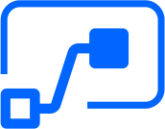

Microsoft Power Platform
The low-code platform that spans Microsoft 365, Dynamics 365, Azure, and standalone applications. Innovation anywhere. Unlock value everywhere.
Power BI
Business analytics
Power Apps
Application development
Power Automate
Process automation
Power Virtual Agents
Intelligent virtual agents
Data
connectors
AI Builder
Common
Data Service
Notes:
To remain competitive, organizations must be able to build agile business processes. To enable organizations have this this agility and empower their users, Microsoft combined the capabilities of four services, Power BI, Power Apps, Power Automate, and Power Virtual Agents into a unique and powerful low-code development platform. While the Microsoft Power Platform has capabilities that can impress any seasoned developer, it is designed to be approachable and accessible to those in the best position to identify transformative applications—those who work on the front lines of a business.

Slide 7
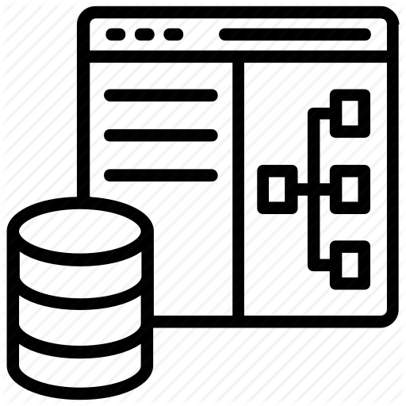
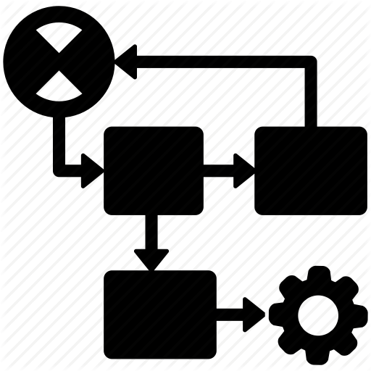


















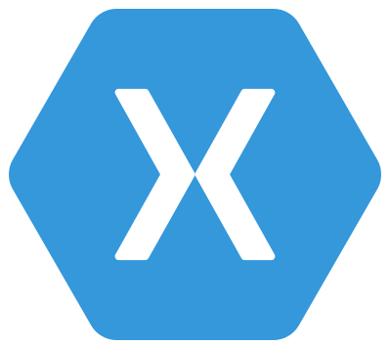

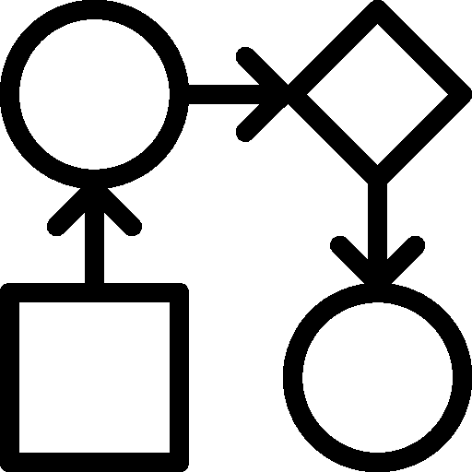
Common Data Service:
What is it?
Integration
Storage
Relational
databases
Eventing
Data
Catalog
and discovery
Files and
blobs
Logic
Log files
Webhooks
Jobs
Modelling
Security
Reporting
Semi-structured
data
Business
Rules
API
Calculated &
Rollup fields
Authentication
Duplicate
Detection
Data
validation
Search and
Find data
Authorization
Plugins
Data export
Common Data
Model
Auditing
Workflows
Data lake
Notes:
If you aren’t familiar with the common data service, let’s take a look at what’s inside.
The Common Data Service is API first – everything you do in CDS creates an API.
CLICK
These are the same APIs are consumed by PowerApps, Power Automate, AI Builder, and PowerBI.
CLICK
Immediately below the API, we have a rich security layer – ensuring that the right people can see the right data, and auditing all access along the way.
CLICK
From there we get to our logic layer, where you can implement custom business logic. Because this logic is below the API, this ensures consistent business logic across ALL applications accessing your data.
CLICK
Then we get to the heart of CDS – our data tier. This allows you to define the structure of your complex business data, without writing code.
CLICK
And, behind the scenes, we’re putting your data in the right place, using the optimal storage services provided by Azure. This allows us to seamlessly support practically any time of data – from relational data to log data to file data to search indexes to data stored in Azure Data Lake.
CLICK
Finally, no deployment of CDS lives alone – it must be integrated with other systems. We provide many ways to integrate CDS with external systems – from eventing to WebHooks to Data Export.

Slide 8
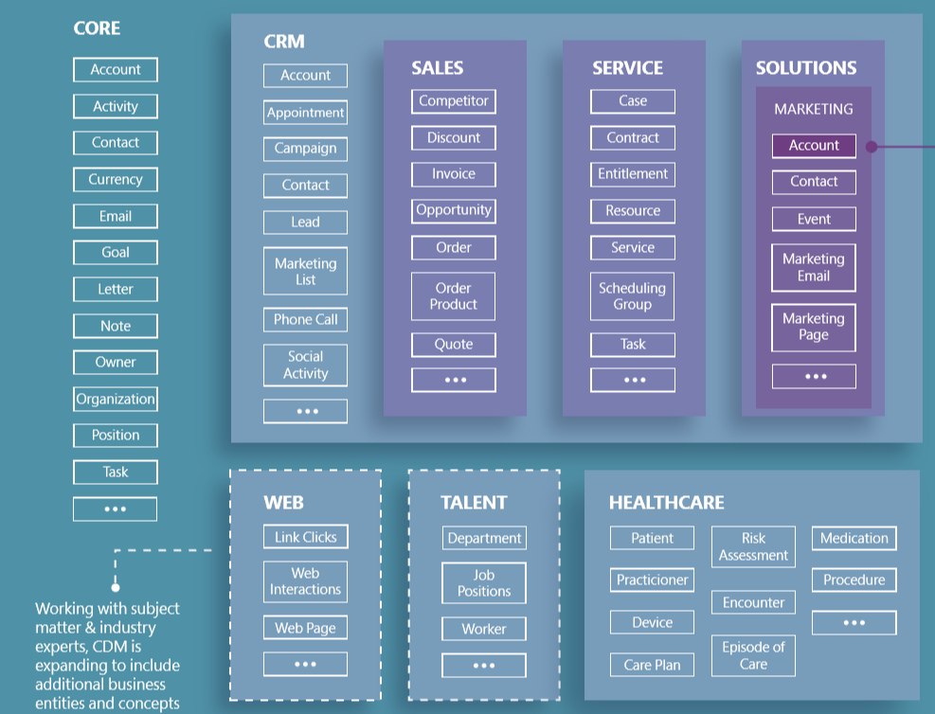
Common Data Model – Jumpstart your build
Use Core Entities
Use EDU Accelerator Entities
Create your own Custom Entities
Dynamics 1st Party Apps consume these same Entities
Capitalize on Industry Accelerators as a building point
Same Data Model used by partners in their solutions

Slide 9
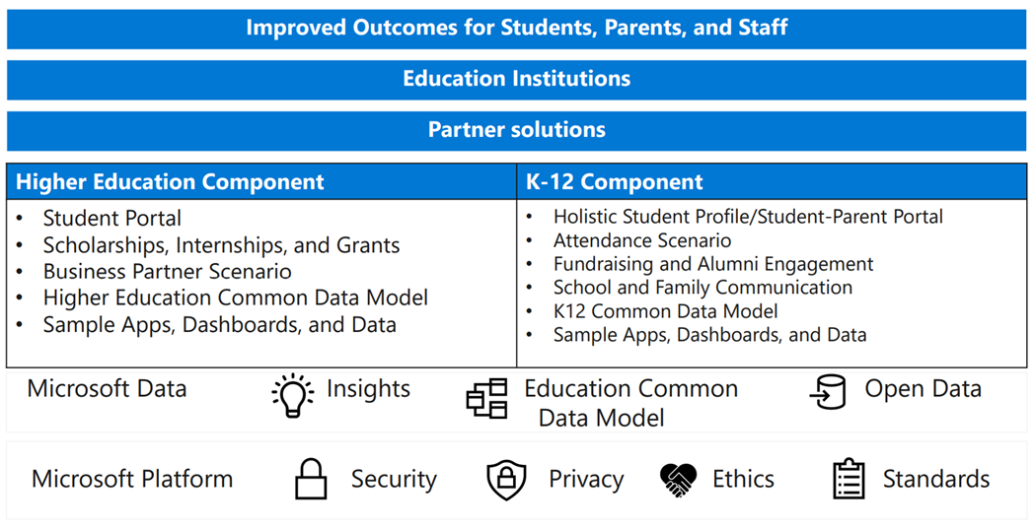
Education Accelerator v3

Slide 10
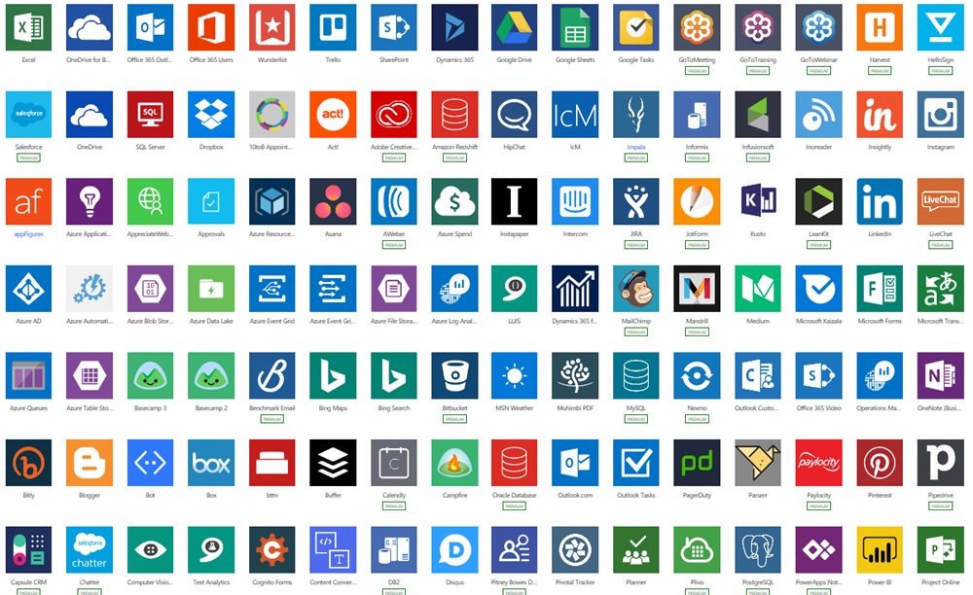
Cloud and on-premises connectivity
Enjoy built-in connectivity to 350+ cloud services, content services, databases, APIs, and other services
Gain seamless hybrid connectivity to
on-premises systems via the on-premises
data gateway
Develop and register custom connectors as building blocks for citizen developers
Break down data silos by using multiple
data sources in a single application
Notes:
Currently, there are more than 350 connectors to a wide range of apps, cloud services, databases, and APIs.

Slide 11
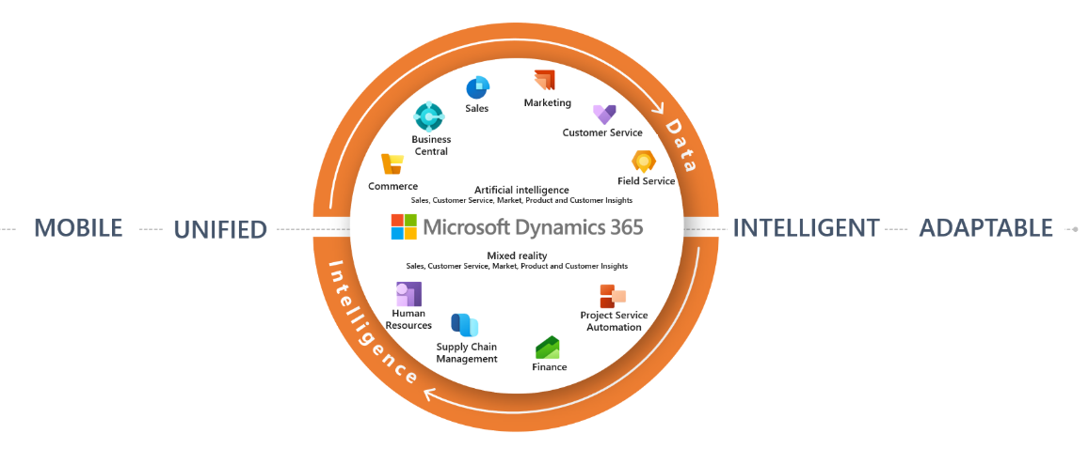
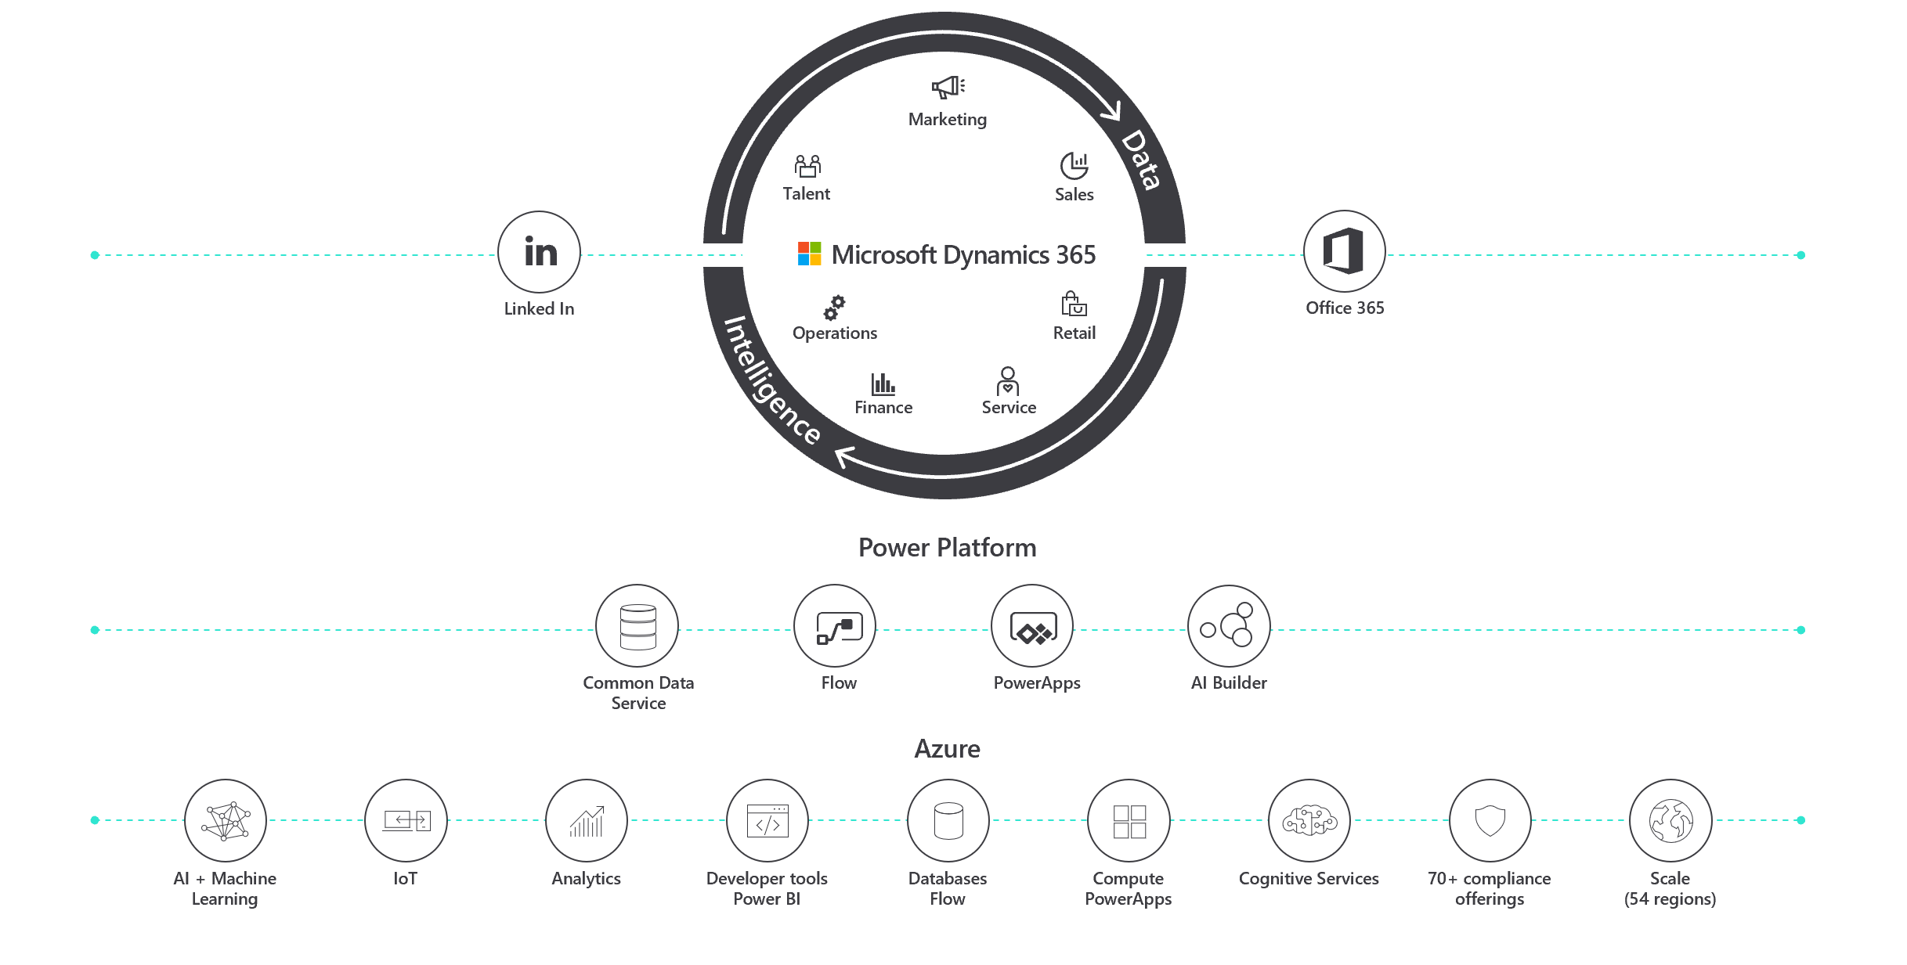
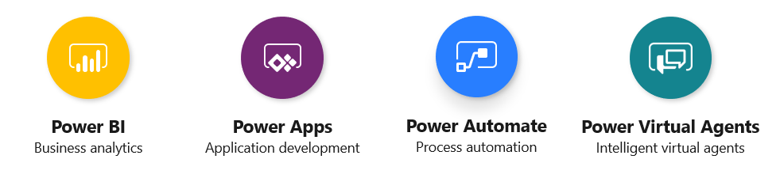
The Power Platform in Context
Intelligence
Data
Notes:
We attribute the above-market growth to innovative platform enhancements we’ve made that empower ISVs to create apps they simply couldn’t build elsewhere.
Our one-of-a-kind platform consists of three layers that are available to you in a completely customizable manner to complement almost any scenario you or your customer might face.
The middle layer is at the heart of the platform’s differentiation for ISVs. It includes the engines, the data service, and the logic to support different build permutations.
AS many of you know, our first-party applications are born from two different stacks. Traditional CRM apps were built on the Power Platform while ERP apps were on a legacy system. These stacks didn’t share data or tools. A lot of ISVs saw the value of the Power Platform stack with the Common Data Service and would use the first-party apps just to access it.
But that’s not how businesses work anymore, and it’s not how digital transformation happens. Today, customers need to be able to share data across groups and apps, and they need solutions tailored for their unique environment and business model. So we rebuilt Dynamics 365 to be an Azure, cloud-native app that uses the Common Data Service (CDS) to standardize data schemas across all apps.
In doing so, we eliminated the traditional silos of ERP and CRM in favor of modular frameworks, and we separated the applications layer from the platform layer to enable better access to Power Apps, CDS, and Flow.
Now, if you want to build a marketing app and don’t want to start from scratch, you can extend our first-party marketing application to suit your needs. Or you can build your own app from the ground up on CDS using Power Apps and Flow. You can even connect an app you already built on a different platform to CDS or by adopting the UX of one of our first-part apps or using a direct data connector.
Choosing Microsoft for your business applications gives you the ability to configure your app to connect with, integrate into, or pull from Office 365 and LinkedIn. Imagine what you can do by bringing these three cloud platforms together to the benefit of your app!
You might choose to:
• embed your sales proposal app in a Word document for customers to access and sign;
• populate your customer’s Talent app with data from LinkedIn;
• use Outlook to help your customers track their sales pipeline;
• or connect your app to SharePoint.
We’ve covered the middle layer with Power Platform and the top layer with Dynamics 365 first-part applications and the Office 365 and LinkedIn cloud platforms.
That leaves the bottom layer. All of this is built on Azure. Azure opens up an infinite number of possibilities and opportunities, including but not limited to integrating AI and Machine Learning, IoT, and Cognitive Services into your solutions.
By plugging into this system—from our first-part apps to Power platform to Azure—allows you to build without limitations. Using the method that works best for you. Its unrivaled capabilities empower you to create breakthrough line of business apps that customers are clamoring for.

Slide 12
First Party Applications
Intelligent Sales & Marketing
Proactive Customer
Service
Connected Field
Service
Modern Finance
& Operations
Connected
Commerce
Dynamics 365 Sales | Dynamics 365 Customer Service | Dynamics 365 Field Service | Dynamics 365 Finance | Dynamics 365 Commerce
Dynamics 365 Marketing | Dynamics 365 Field Service | Dynamics 365 Marketing | Dynamics 365 Supply Chain Management | Dynamics 365 Marketing
Dynamics 365 Customer Insights | Dynamics 365 Marketing | Dynamics 365 Customer Service | Dynamics 365 Business Central | Dynamics 365 Connected Store
Dynamics 365 Sales Insights | Dynamics 365 Customer Insights | Dynamics 365 Customer Insights | Dynamics 365 Human Resources | Dynamics 365 Fraud Protection
Dynamics 365 Market Insights | Dynamics 365 Customer Service Insights | Customer Voice | Dynamics 365 Fraud Protection | Dynamics 365 Customer Insights
LinkedIn Sales Navigator | Dynamics 365 Virtual Agent for Customer Service | Dynamics 365 Remote Assist | Dynamics 365 Guides | Dynamics 365 Layout
Customer Voice | Dynamics 365 Product Insights | Dynamics 365 Guides | Dynamics 365 Layout
Dynamics 365 Product Visualize | Customer Voice
 | Dynamics 365 Guides
Power Platform | Power BI | Power Apps | Power Automate | Power Virtual Agents | AI Builder | Portals
Notes:
Mixed Reality Solutions
Layout – Visualize room layouts with holograms in the physical world or in virtual reality. Easily import floorplans from Microsoft Visio and 3D models from other apps to experience designs at scale and in context.
https://dynamics.microsoft.com/en-us/mixed-reality/layout/
Forms – Survery tool
Remote Assist – https://dynamics.microsoft.com/en-us/mixed-reality/remote-assist/?&OCID=AID2000546_SEM_XieFmgAABfCOKeFk:20200121231330:s&msclkid=a85c4837571a183518bd1610d29774e0&ef_id=XieFmgAABfCOKeFk:20200121231330:s
Empower technicians to collaborate more efficiently by working together from different locations with Dynamics 365 Remote Assist on HoloLens, Android, or iOS devices.
Guides - Help employees learn new skills faster with Dynamics 365 Guides on HoloLens devices—no coding required.
https://dynamics.microsoft.com/en-us/mixed-reality/guides/
Product Visualize - Help your sellers meet their customers’ needs faster with mixed reality. Using Dynamics 365 Product Visualize, now in preview for iOS, sales representatives can place a 3D digital twin of a product in their customer’s environment, let them explore it as if it’s physically there, and make detailed notes about their requirements.
https://dynamics.microsoft.com/en-us/mixed-reality/product-visualize/

Slide 13
Power Platform Education Process Examples
Internal/Employee Use Cases
  School Directory
  Return to Work
  Time Off Request
  Purchase Request
  Time Entries
  Expense Submission
  Travel Request Approval
  Leave of Absence Request
  Security Badge Request
  Request Parking Space
  Consumables Request
  Teaching Certificate Management
  Teaching Endorsement Management
  Inventory Software Used in the Classroom
  Accounting Journal Entry
  Media Relations
Student Use Cases
  School Directory
  Return to School
  Change of course
  Scholarships and Scholarship Applications
  Internship and Internship Applications
  Capturing student being tardy
  Student Gamification
  Behavior Reward Solution for K-12 students

Slide 14
Education Build Examples
Student
  Recruitment
  Enrollment
  Student Success
  Career Services
  Student Portal
Parent Portal Experience
  Case Management
  KB Consumption
  Review child profile
Marketing
  Mass Email Communication
  Event Management
Employee Portal
  Case Management
  Teaching Certificate Management
  Endorsement Management
  Time Off Requests
  Employee Requests
Business Partner Management
  Volunteer/Guest Lecture
  Internships
  Scholarships
  Donations
  Sponsorship Opportunities
  Sell Professional Services including Training
  Lease space for meetings and events
  Club/Org Participation
  Business Partner Portal

Slide 15
Power Platform Application Examples

Slide 16
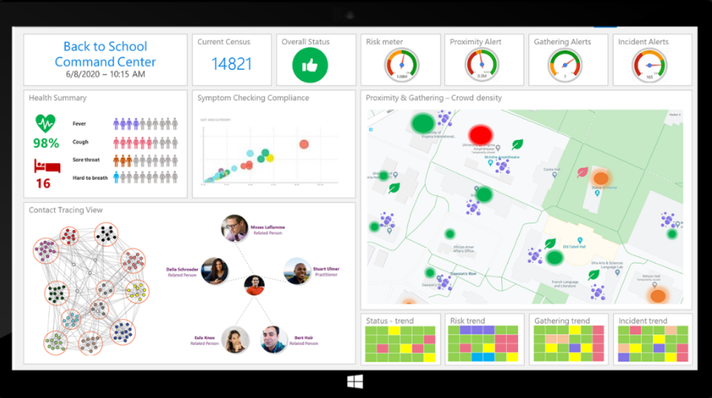
Mazik Back to School Solution
A return to campus solution that's safer, well-managed, and creates confidence for everyone.
Mazik Global’s Back-to-School solution offers secure symptom and risk tracking, case management, and workflows that give administrators real-time visibility into who’s healthy enough to rejoin and remain on campus, empowering you to make decisions faster, keep staff and students safer, and ensure your school year remains on track.
https://www.mazikglobal.com/creating-campus-confidence-in-the-time-of-covid-19/

Slide 17
Always-On Enterprise Customer Service with Dynamics
Enable 24/7 support with self-service portals and chatbots to meet any volume
Personalize customer conversations with student/employee/parent/business partner profiles and interaction data consolidated within a single form
Improve customer engagement by tracking customer feedback and sentiment with surveys
Provide support staff with a 360-degree view of related records necessary to support all personas and processes
Scale to support more with the same resources
Create virtual interactions that go beyond live chat with screen share and file share to assist customers
Maximize engagement by focusing on the customer, not the technology

Slide 18


Feature summary
Dynamics 365 Customer Service
Self-service
Agent productivity
AI & insights
Proactive service
Omnichannel engagement
Knowledge articles​
Virtual agents​
Portals​
Relevance Search for Knowledge Base​
SLAs and Entitlements​
Smart assist agent recommendations​
Agent guidance using scripts and macros​
Insights into customer self-service efforts​
Work scheduling ​
Multisession engagement​
Unified routing for case and entity records​
Skills-based routing for work distribution to best-fit agents​
Expanded digital messaging channels​
Co-browse and remote assistance integration​
Elevate live chat to voice or video​
360-degree customer view​
Performance & trends across channels​
Agent performance and utilization​
Real-time sentiment analysis​
Greater visibility ​ into insights​
Measure ​ customer impact on CSAT scores​
Topic clustering &​ automation​
Proactive chat​
Connected Customer Service​
Proactive ​ insights​
​ Diagnose and ​ fix connected devices remotely​
​ IoT alerts and ​ notifications​
Notes:
We have more than 30 new releases and feature enhancements this latest wave so I’m going to walk through the highest impact updates today. I’ll share these updates within the context of how they benefit customer service organizations. For the complete list and full feature details we’ll provide a link to the documentation at the end of this presentation.

Slide 19
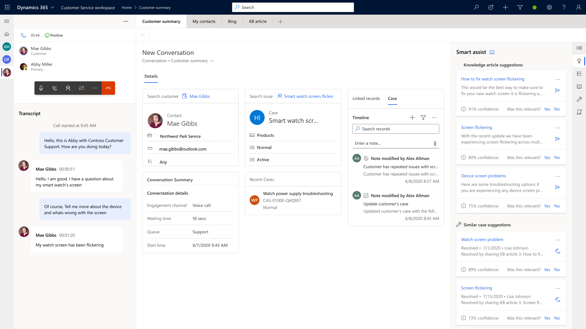
Omnichannel engagement
First party voice channel
Built on the familiar Dynamics 365 platform to provide a fully integrated, AI-driven experience across all channels
Visibility into trends across all channels
Leverage AI to resolve issues faster
Create true omnichannel experiences
*Limited Preview
Notes:
We are pleased to introduce first-party voice channel, built on the familiar Dynamics 365 platform. This new voice channel empowers organizations to provide a seamless, end-to-end customer service experience to deliver consistent, connected support across channels.
First-party voice provides a fully integrated, AI-driven experience for both agents and customers across all channels. It is integrated in the same, seamless manner as all pre-existing engagement channels within Customer Service. This saves CSS admins and implementors time and money as they’re working with the same vendor in a familiar product experience.
A few other benefits include:
Get instant visibility into trends across all channels. With native voice channel integration enabled by Azure Communication Services, you have immediate access to insights from customer interactions through advanced AI-driven topic clustering to quickly identify factors impacting customer satisfaction.
Put AI to work for you. From self-service solutions like conversational IVR to real-time agent productivity tools like call transcription, sentiment analysis, and knowledge article recommendations, lean on built-in AI to resolve customer issues faster.
Create true omnichannel experiences. Whether the conversation take place on a voice or digital messaging channel, the agent experience remains consistent and connected. Agents receive full context of previous customer interactions across all channels, resulting in highly personalized customer experiences and more successful outcomes.

Slide 20
Demo – Employee end to end agile processes
School Employees

Slide 21



Why is Williams School considering Power Platform?
Need to deliver more agile end to end business processes
Continue to push paper and PDFs to execute processes
Own older applications that are expensive and limited in capabilities
No easy way to wrap Notes and Activities around a process
Approval processes are less than ideal
Much of the process detail is trapped in Email correspondence
Reporting difficult at best; No analytics on processes executed
Need to modernize the App building experience
Growing backlog of Apps needed to run the business
Currently Apps are time consuming to deliver and expensive to update
Excessive coding needed to integrate to other applications
Apps don’t work on all browsers or all devices
Apps need to be secure and we need to know who is using them

Slide 22
Demo Elements Williams School – Built on CDS database
Model Driven App
Power Platform Portal – Employee Portal
Employee Canvas App
Power Automate
Power BI
Power Virtual Agent
Customer Voice
Outlook Integration
Teams Integration

Slide 23
Demo

Slide 24
Business value delivered to Williams School
Greatly increased employee satisfaction and reduced turnover
Modern way to execute processes with pages and forms surrounded by activities that integrate with O365
Reduced operating costs by retiring old technologies
An agreed upon school data estate/data model that once deployed in CDS, allows for virtually unlimited process management via Power Apps
Agreed upon platform solution allows for building center of excellence among all app builds; reusable components are possible
Database and Apps are secure via Azure and Azure AD Authentication
Low-code/no-code app builders AND full suite capabilities for DEV Ops Teams
Analytics and AI available now versus siloed On-Premises databases
Compliance and historical tracking automatically delivered via CDS

Slide 25
Williams School – Digitally transforming with the Power Platform
PROBLEMS SCHOOL WAS FACING
Continue to push paper and PDFs to execute processes
Own older applications that are expensive and limited in capabilities
No easy way to wrap Notes and Activities around a process
Approval processes are less than ideal
Much of the process detail is trapped in Email correspondence
Reporting difficult at best; No analytics on processes executed
Continue to push paper and PDFs to execute processes
Own older applications that are expensive and limited in capabilities
No easy way to wrap Notes and Activities around a process
Approval processes are less than ideal
Much of the process detail is trapped in Email correspondence
DIGITAL TRANSFORMATION USING POWER PLATFORM
School defined their unique Data Model in CDS using Common Data Model base entities, EDU Industry Accelerator, and custom entities
Deploy Model Driven Apps using Common Data Service
Designer experience for low-code, no code builders and full DEV Ops team
Web UI provides forms, views, charts, and dashboards
Power Platform Portal eliminates paper processes and fosters self-service
Canvas App for pixel-perfect mobile app experience connecting to the CDS database
Power Automate provides connectors, workflow, and Process Flows to streamline, automate, and standardize processes
Power BI is our robust data and AI analytics tool that directly connects to our CDS database
Power Virtual Agent to assist people using bot connected to CDS database to call existing and create new records
Customer Voice is the survey solution that provides a continuous feedback loop for process improvement
Engineered to work seamlessly with Microsoft technology stack

Slide 26
Resources

Slide 27
Resources
POWER APP DESIGN
https://docs.microsoft.com/en-us/powerapps/powerapps-overview
https://docs.microsoft.com/en-us/powerapps/maker/model-driven-apps/model-driven-app-overview
https://docs.microsoft.com/en-us/powerapps/maker/common-data-service/data-platform-intro
https://docs.microsoft.com/en-us/power-automate/getting-started
https://docs.microsoft.com/en-us/powerapps/maker/portals/overview
https://docs.microsoft.com/en-us/powerapps/use-ai-builder
https://powerapps.microsoft.com/en-us/blog/
https://powerusers.microsoft.com/t5/Power-Apps-Community/ct-p/PowerApps1
POWER PLATFORM ADMINISTRATION
https://aka.ms/CoEStarterKitDownload
https://aka.ms/powerappsadminwhitepaper
https://powerusers.microsoft.com/t5/Forums/ct-p/PA_Comm_Forums
https://www.powerappsug.com/home
https://aka.ms/powerapps/admininaday
https://docs.microsoft.com/en-us/power-platform/admin/admin-guide
EDUCTION INDUSTRY ACCELERATOR
https://github.com/microsoft/Industry-Accelerator-Education/releases/tag/3.0.0.0
MICROSOFT LEARN SITE
https://docs.microsoft.com/en-us/learn/powerplatform/

Slide 28
Virtual event Tuesday, December 15, 2020 10:00 AM–1:30 PM (Pacific Time)
Gain the skills to help your organization create innovative solutions for an evolving business environment
Drive innovation, support development, and rapidly respond to today’s evolving business challenges with Microsoft Power Platform Virtual Training Day: Fundamentals. During this free two-part event, you will discover how Power BI, PowerApps, and Power Automate can work together to allow everyone in an organization to build custom apps, automate workflows, and analyze data—regardless of technical expertise. Gain the skills to help your organization create innovative, future-proof solutions for an evolving business environment.
You’ll learn how to:
Prepare for the Microsoft Power Platform Fundamentals certification exam.
Build and manage innovative business solutions with Power Platform.
Easily connect all your data to analyze business performance with custom-built apps.
Automate workflows to improve daily processes, regardless of your technical expertise.
Ready to become certified? After completing this free training, you’ll be eligible to take the Microsoft Power Platform Fundamentals certification exam at no cost.
Gain the insights and confidence you need to support development, innovation, and crisis response in your organization. Space is limited—reserve your virtual seat today.
Registration link:
https://mktoevents.com/Microsoft+Event/209340/157-GQE-382

Slide 29
Wrap Up and QA

Slide 30
Thank You!
Stan Ray
US EDU Power Platform and Dynamics Team
StanRay@Microsoft.com

